Slide 1
DSA3101
Group 3
FRANCELINE BENETTA (A0200662U),
GORDON THAM QI HAO(A0204749Y),
KUEI YU FEI (A0205517L),
LEE MIN LI (A0205279B),
LOW HON ZHENG (A0204803R),
LOW JIA LIN (A0204877W),
SAW LIN MIN (A0205450U),
USMAN HASAN SIDDIQUI (A0201488E)

Slide 2

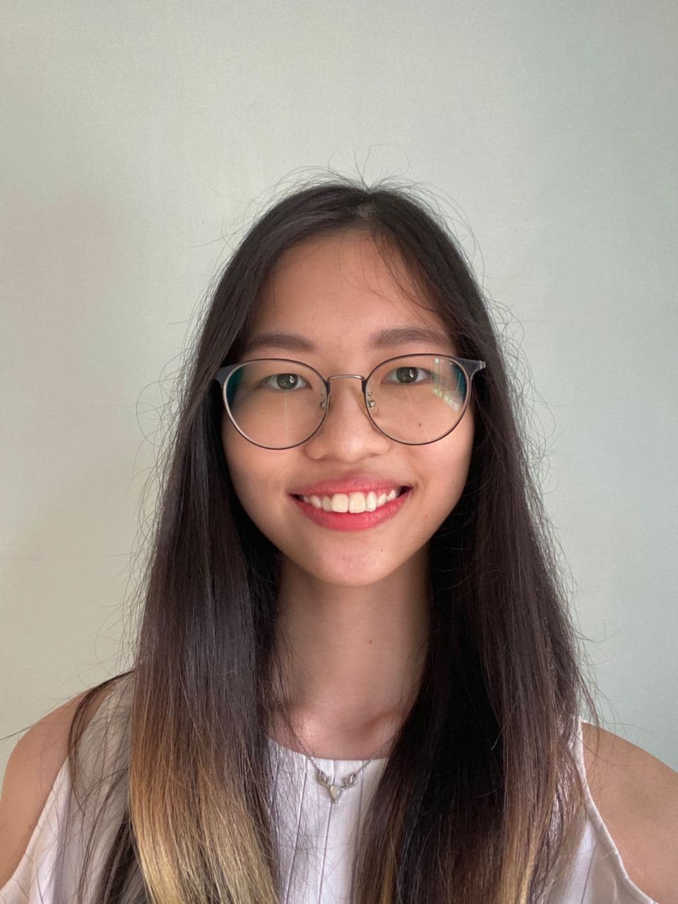
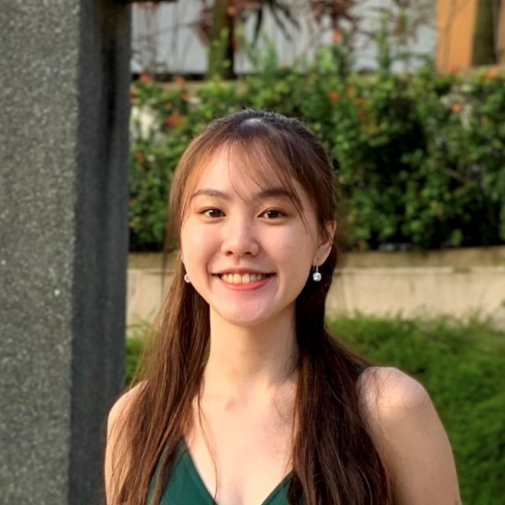
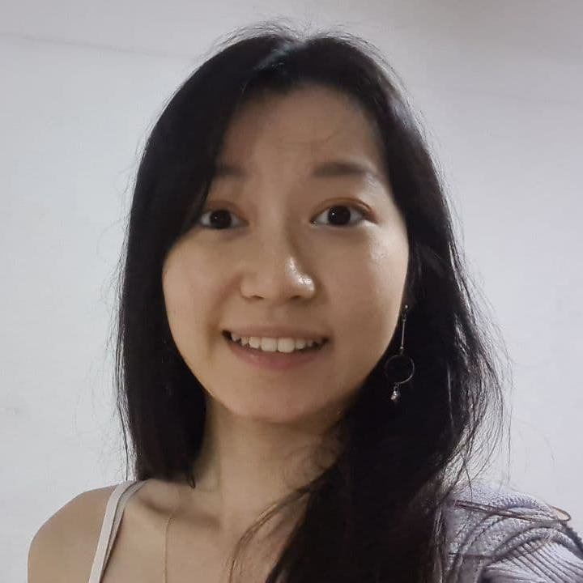
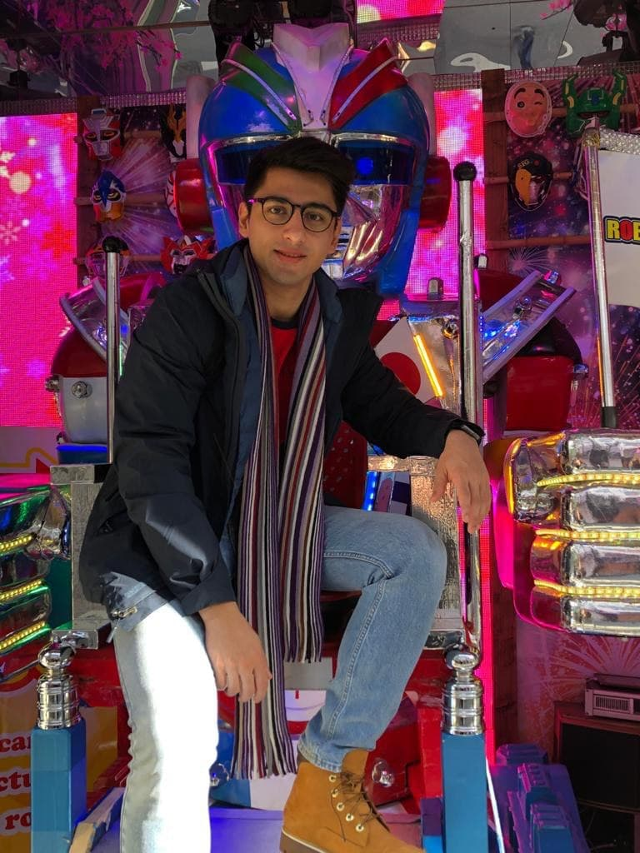
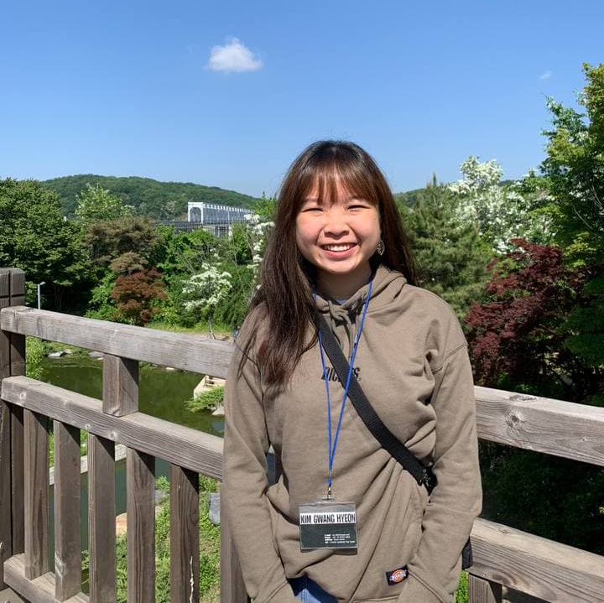
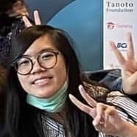
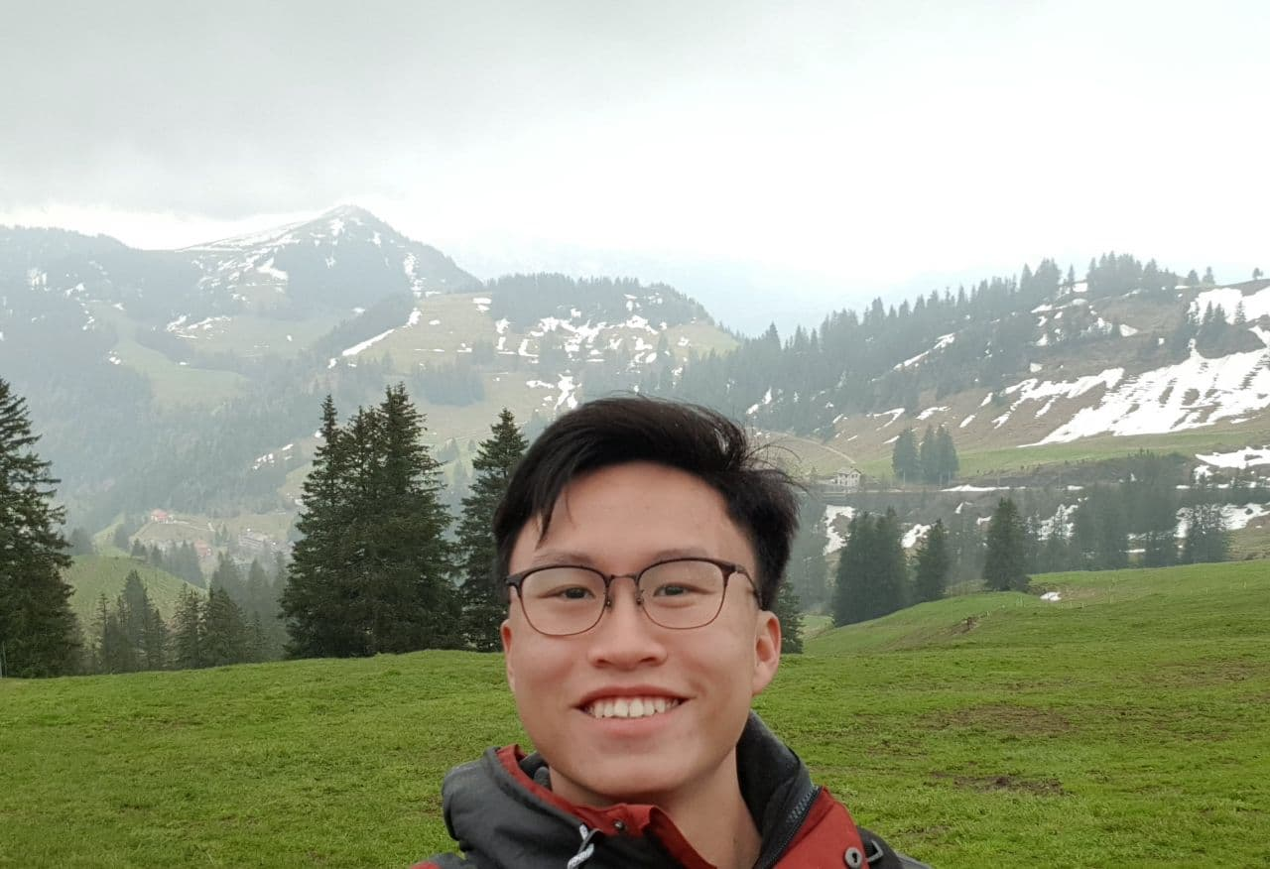
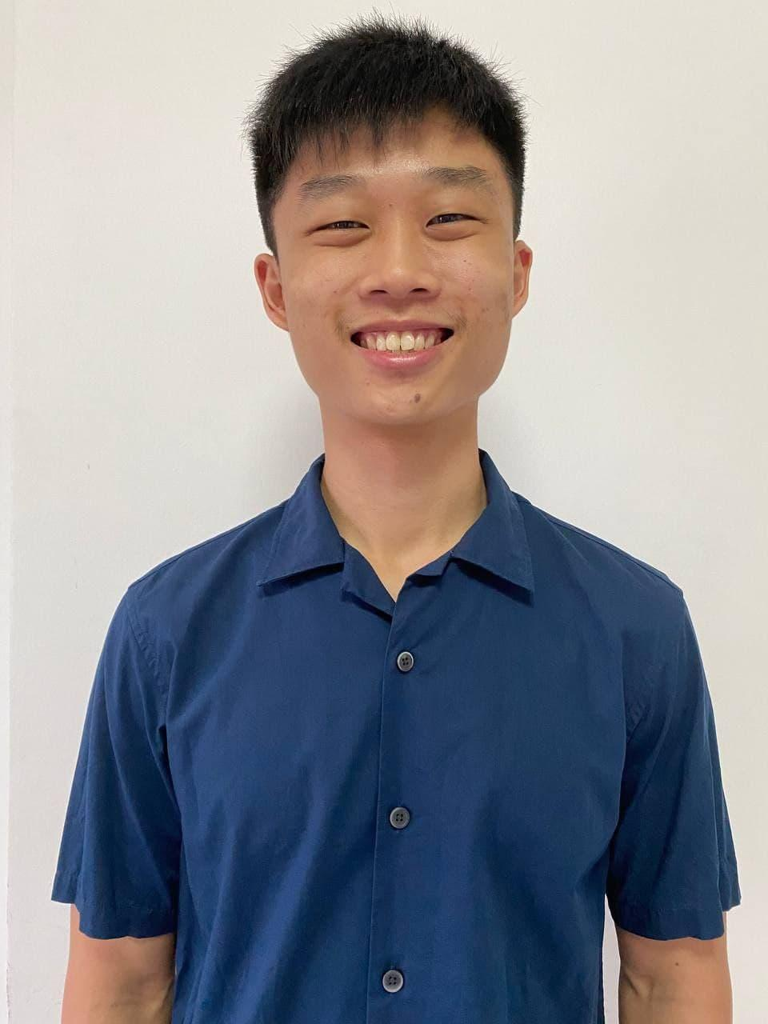
Meet the team...
Kuei Yu Fei Data Engineer
Low Jia Lin Data Engineer
Lee Min Li Data Scientist (Clustering)
Usman Siddiqui Founder
Saw Lin Min Data Scientist (Clustering)
Franceline Benetta Data Scientist (NLP)
Gordon Tham
Data Scientist (NLP)
Low Hon Zheng Data Analyst

Slide 3
Introduction
1
Business idea & objective

Slide 4
Niche Hypothesis
Trend:
All hotels have a certain target audience and their marketing/sales strategies isolate that group
Market Gap:
No hotels catering to all types of travellers

Slide 5





Business Idea and Objectives
Establish our first Luxury Hotel in Brussel, Belgium
Aim to accommodate a wide variety of travellers at the same time
Maximise Revenue
Implement desirable features to our hotel

Slide 6
How?
Hypothesis
EDA
Clustering
Sentiment Analysis
LDA
Strategy

Slide 7
Data Analysis
2
Data Wrangling & Exploration

Slide 8



Data Exploration
Data:
Hotel Reviews
Country:
Belgium
Review Dates:
July 2018 - July 2021
Top 10 highest and lowest rated [4 stars and above] hotels

Slide 9

Data Wrangling
Additional information:
Hotel - accomodation type, room type, price per night
Reviewer - number of nights stayed, traveller type, total spending, booking frequency
Quarter of the year

Slide 10

What are the
TRENDS?

Slide 11
Histogram of reviewer ratings
Count
800
600
400
200
700
500
300
100
0 2 4 6 8 10
Reviewer Hotel Ratings

Slide 12

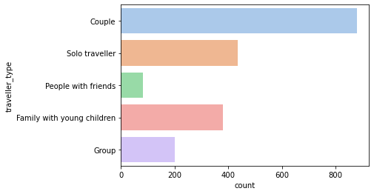

Traveller type breakdown
1
1
2
Deals
3
2
3
Security

Slide 13
Competitor Perceptual Map
HIGHER AVERAGE PRICE PER NIGHT
Higher prices,
Higher ratings?
LOWER HOTEL RATING
HIGHER HOTEL RATING
Cheaper prices,
Lower ratings?
LOWER AVERAGE PRICE PER NIGHT

Slide 14
Cluster Models Analysis
3
DBSCAN, K-Means, K-Prototype
(Unsupervised Learning)

Slide 15
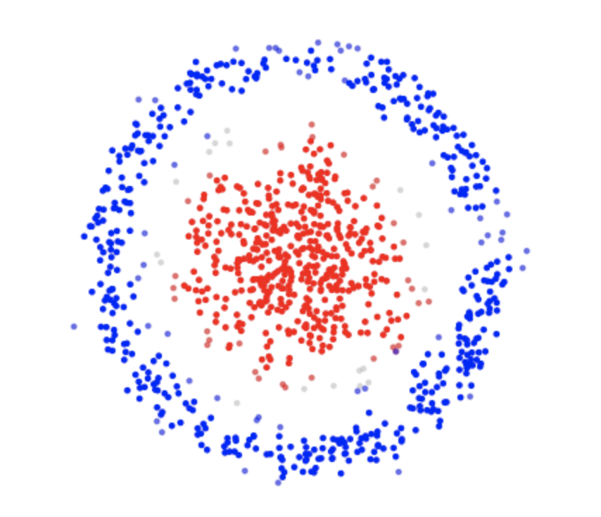
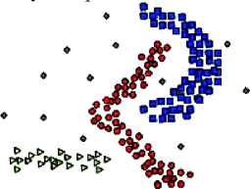

DBSCAN
Density-Based Spatial Clustering of Applications with Noise

Slide 16

DBSCAN Results
Cluster | Total
0 | 941
1 | 259

Slide 17
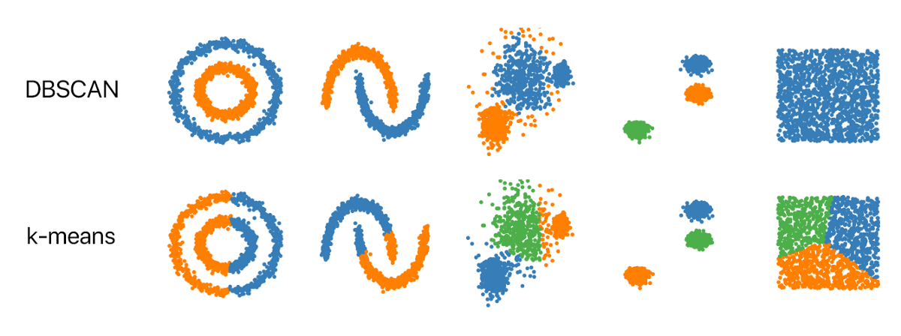
Next Model

Slide 18
K-Means: Cluster Results
K = 2:
K = 3:
Cluster | Total Spending | Booking Frequency | Rating | Total
0 | 227.19 | 1.46 | 8.65 | 1053
1 | 767.61 | 1.39 | 8.84 | 147
Cluster | Total Spending | Booking Frequency | Rating | Total
0 | 190.04 | 1.42 | 8.63 | 869
1 | 481.80 | 1.52 | 8.75 | 293
2 | 1204.26 | 1.66 | 9.16 | 38

Slide 19
K-Prototype
K-Means
+
Continuous
K-Prototype
Categorical
K-Modes
K-Means: Measures the distance between continuous variables using euclidean distance
K-Modes: Measures the distance between discrete variables using dissimilarity coefficients

Slide 20
K-Prototype
Cluster Results for K = 3:
Silhouette score: 0.152
Cluster | Total | Traveller Type | Quarter | Price Per Night | Rating of Hotel
0 | 102 | Group | 4 | 283.667 | 9.296
1 | 382 | Group | 1 | 182.144 | 8.790
2 | 716 | Solo Traveller | 4 | 118.251 | 8.521

Slide 21

Best Model: K-Prototype
Silhouette score: 0.189
Cluster Results for K = 4:
Cluster | Total | Traveller Type | Quarter | Price Per Night | Rating of Hotel
0 | 208 | Group | 3 | 211.125 | 8.951
1 | 435 | Solo Traveller | 1 | 103.814 | 8.431
2 | 492 | Couple | 4 | 150.807 | 8.662
3 | 65 | Couple | 4 | 306.323 | 9.474

Slide 22
Analysis of cluster results
4 distinct clusters
Cluster | Total | Traveller Type | Quarter | Price Per Night | Rating of Hotel
0 | 208 | Group | 3 | 211.125 | 8.951
1 | 435 | Solo Traveller | 1 | 103.814 | 8.431
2 | 492 | Couple | 4 | 150.807 | 8.662
3 | 65 | Couple | 4 | 306.323 | 9.474
Cluster 0: Group travellers with medium budget
Cluster 1: Solo travellers with low budget
Cluster 2: Couple with low budget
Cluster 3: Couple with high budget

Slide 23
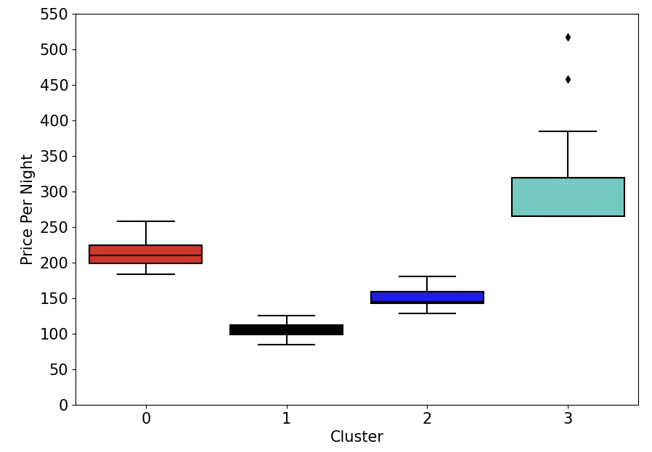
Analysis
of cluster results
Key Observations:
Clusters well-separated by price per night
Useful to gauge the pricing tiers of our hotel
Low variability within each cluster
2 outliers in cluster 3 were kept

Slide 24

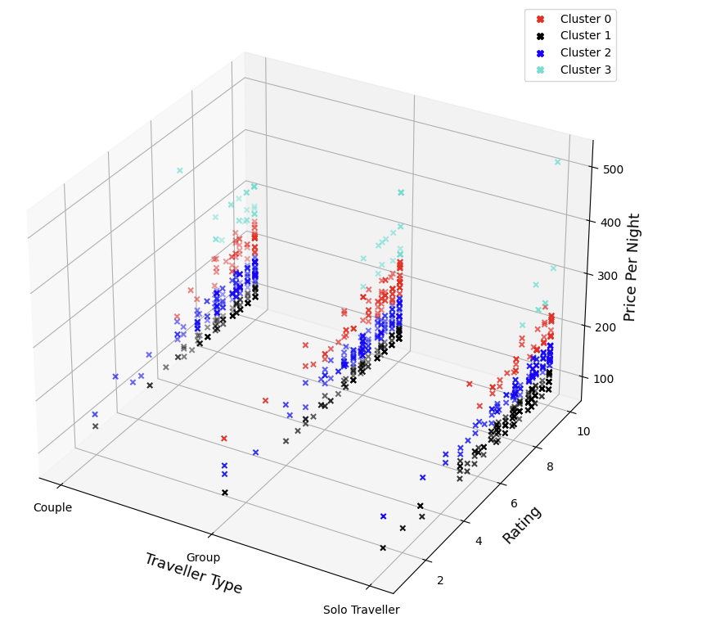
Analysis
of cluster results
Price Per Night is proportional to Rating
Customers are willing to pay to have a pleasant experience
Most customers have low budget (Cluster 1 and 2)
Pricing tiers should account for lower budget customers

Slide 25

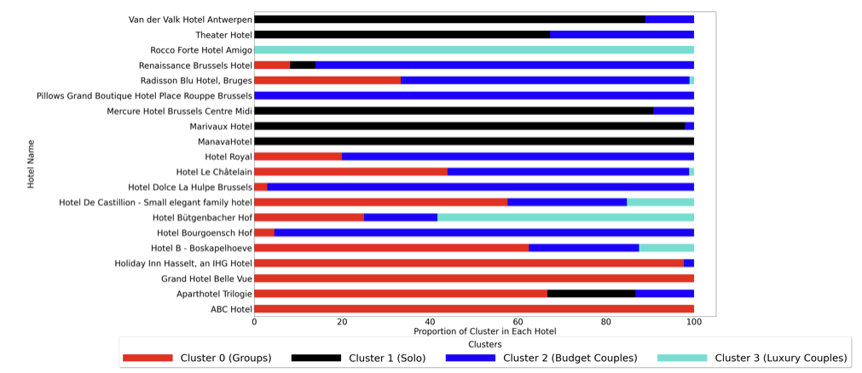
Niche Hypothesis
Confirms hypothesis:
Most hotels only cater to specific type of traveller
Market Gap: No hotel that caters to all type of travellers

Slide 26
Reviews Exploration
4
NLP - Sentiment Analysis

Slide 27
Exploration Process
Further cleaning for sentiment analysis
Basic cleaning
Visualisations
1
3
5
2
4
6
Split reviews into individual sentences
Use LDA for topic modelling
Derive most prominent nouns and draw insights

Slide 28


Basic Text Cleaning
The hotel room was BIG and specious.\n
the hotel room was big and spacious.
There are no reviews here.

Slide 29

Split Review
the hotel room was big and spacious. the breakfast served was also delicious.
---------
the hotel room was big and spacious.
the breakfast served was also delicious.

Slide 30
Secondary text cleaning
1
Split sentences into words
2
Remove words that have numbers in them
3
Remove stopwords
4
Lemmatization
5
Remove words of length <= 1

Slide 31




Sentiment Analysis
Sentiment score of sentences
room nice
food meh

Slide 32
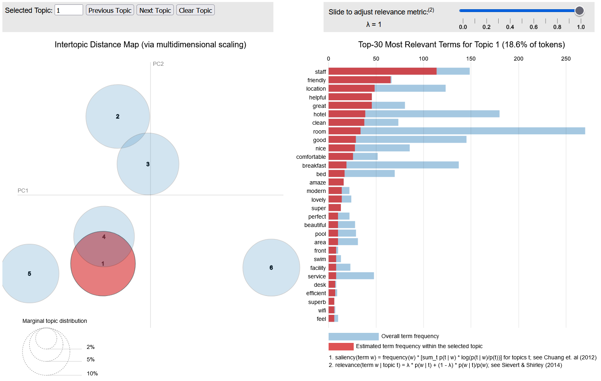
Latent Dirichlet Allocation (LDA)

Slide 33
Latent Dirichlet Allocation (LDA)
Location | Food related | Hotel amenities / vicinity | Room amenities | General comments | Staff / service
location | breakfast | hotel | room | park | staff
walk | coffee | clean | comfortable | check | friendly
station | price | shower | modern | night | helpful
city | tea | noise | bed | recommend | service
metro | quality | day | bathroom | reception | excellent
convenient | choice | dirty | shower | active | expect
... | ... | ... | ... | ... | ...
6 Groupings from Cluster 2 and words assigned to it

Slide 34

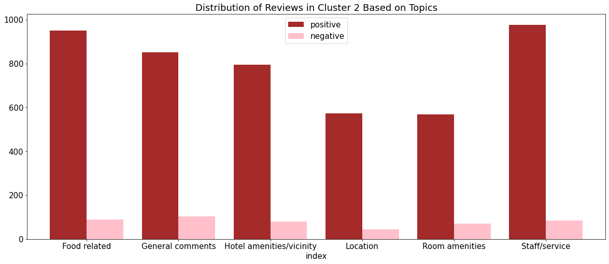
Analysis of reviews

Slide 35



What are the things people say about the hotels?

Slide 36
Feedback
Topic | Cluster 0 (Groups) | Cluster 1 (Solo) | Cluster 2 (Couples)
Location | Parking | Station | Station
Food related | Breakfast | Breakfast | Breakfast
Room amenities | Bed | Bathroom | Bathroom
Staff/service | Staff | Staff | Staff
Hotel amenities/vicinity | Pool | Bathroom | Location
General comments | Hotel | Hotel | Room

Slide 37
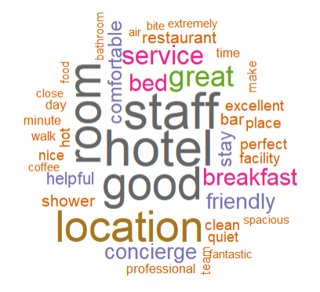
Cluster 3 Analysis
Word | Frequency
hotel | 39
staff | 39
good | 35
room | 35
location | 35
“The staff were outstanding, warm and kind and everyone knew my name from when i checked in.”
“When we reached the hotel the concierge team welcomed us warmly with dozens of suggestions on how to spend the next 3 days.”
“I can easily say that I have never experienced a more professional concierge service like the one I have received …”

Slide 38
Conclusion
5
Recommendations and Business Objective

Slide 39
what are some
RECOMMENDATIONS?

Slide 40
Baseline Prices
Room type | Type of Traveller | Baseline Price | Number of rooms
Single Deluxe | Solo | €211 | 70
Deluxe Room | Couples on a lower budget | €103 | 145
Family Suite | Groups | €151 | 165
Luxury Suite | Couples on a high budget | €306 | 20

Slide 41
Pricing Recommendations
Quarter | Type of Traveller | Strategy
1 | Solo | Offer single rooms at discounted price
2 | All | Seems to be non-peak travel period, market low prices online and improve brand recognition
3 | Group | Offer attractive room bundles along with bundled tickets for tourist attractions
4 | Couples | Offer Added incentives to our luxurious rooms (suites)

Slide 42









Hotel Features Recommendations
Topic | Cluster 0 Groups | Cluster 1 Solo | Cluster 2 Couples
Location | Cheap, secure, reserve parking | Near train station | Near train station
General | Modern Facade | Aesthetic | High Hygiene levels
Service | Friendly, Helpful, Polite and well-manned
Room | Comfortable and large beds | Bathrooms with quality products | Large Bathrooms
Food | High quality food in a dining hall | Breakfast with a large variety | Complimentary Breakfast Buffet
Hotel Amenities | Well Equipped Gym and pool | Bathrooms aesthetic and equipment | Strategic Location

Slide 43
Thank You!
Any questions?

Slide 44
ANNEX

Slide 45
SUMMARY

Slide 46
1
Group travellers with medium budget
Solo travellers with low budget
K-Prototype model:
we identified 4 clusters which provide meaningful insights
0
1
Couples with low budget
Couples with high budget
2
3

Slide 47



2
We met our objective of using the clusters to come up with appropriate pricing and marketing strategies with revenue maximising goals in mind

Slide 48


3
Our niche hypothesis was also confirmed when we plot the Hotel against Proportion of Cluster in each hotel

Slide 49


4
From the sentiment analysis and LDA method, we have identified 6 main topics that the reviews can be categorised under.
From there, we analysed the distribution of the reviews in each topic and cluster and deep dived into the individual reviews to gain insights from the experience hotel goers had with other hotels.

Slide 50
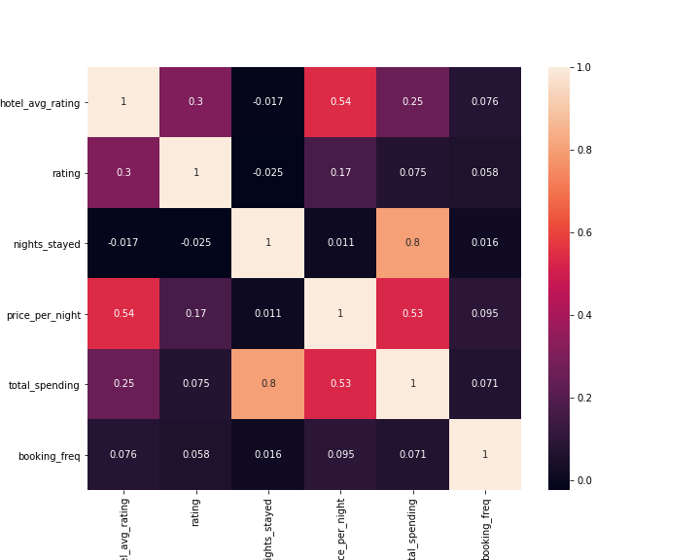
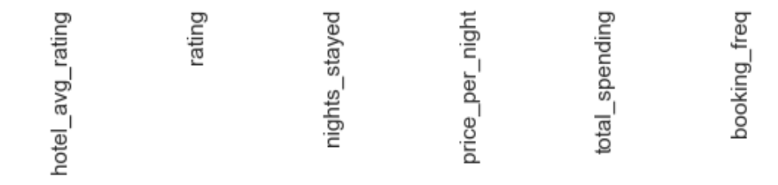
Correlation heatmap
2
3
1

Slide 51
DBSCAN - Variables Used
Nationality
Traveller Type
Room Type
Quarter of the Year
Nights Stayed
Rating
Booking Frequency
Price Per Night

Slide 52
DBSCAN
Label Encoder
Single Room
Double Room
Deluxe Room
Family Suite
1
2
3
4
Categorical Variables
Numerical Variables

Slide 53



K-Means
Rating
Uses Pairwise Euclidean distances between data points
Booking Frequency
Total Spending
Continuous Variables

Slide 54
Price Per
Night
Rating
K-Prototype Variables
Used
Type of
Traveller
Quarter of
the Year

Slide 55
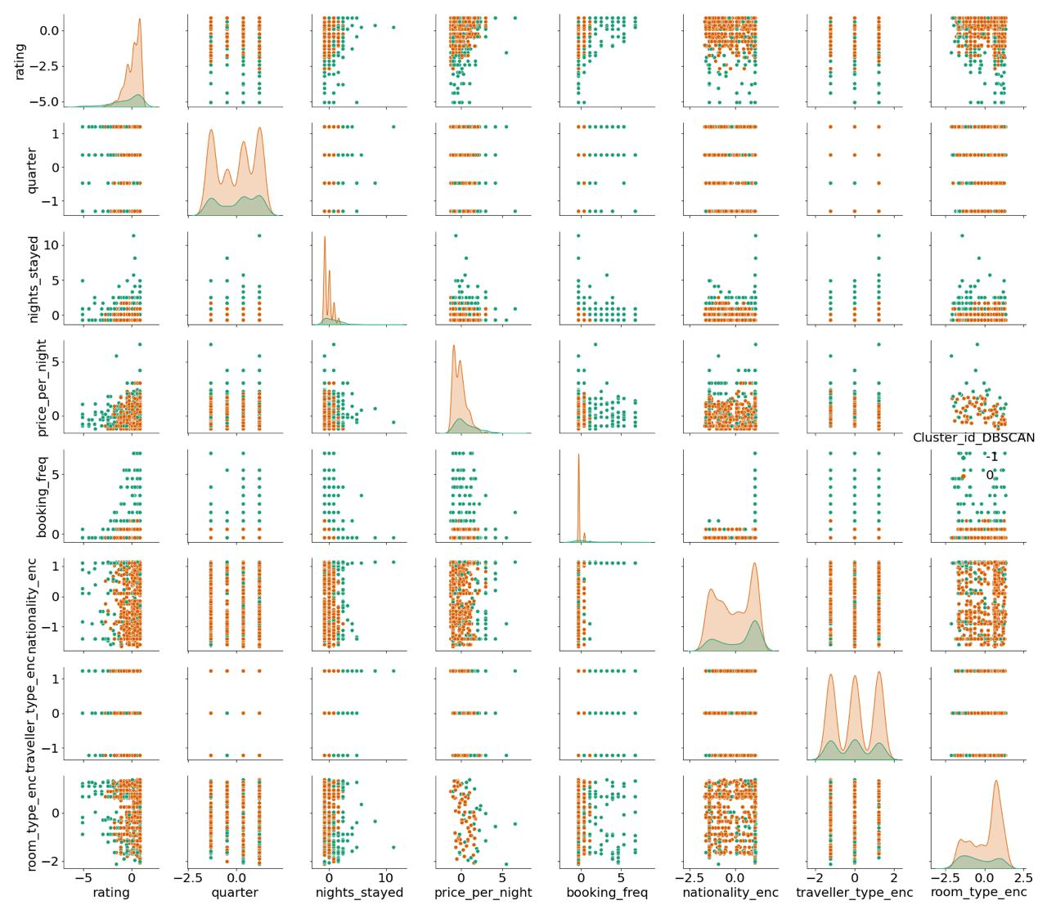

Slide 56


Latent Dirichlet Allocation (LDA)
Pillow
was
soft
Food
Tastes
Delicious
Topic 1
Topic 2
. . .

